Slide 1
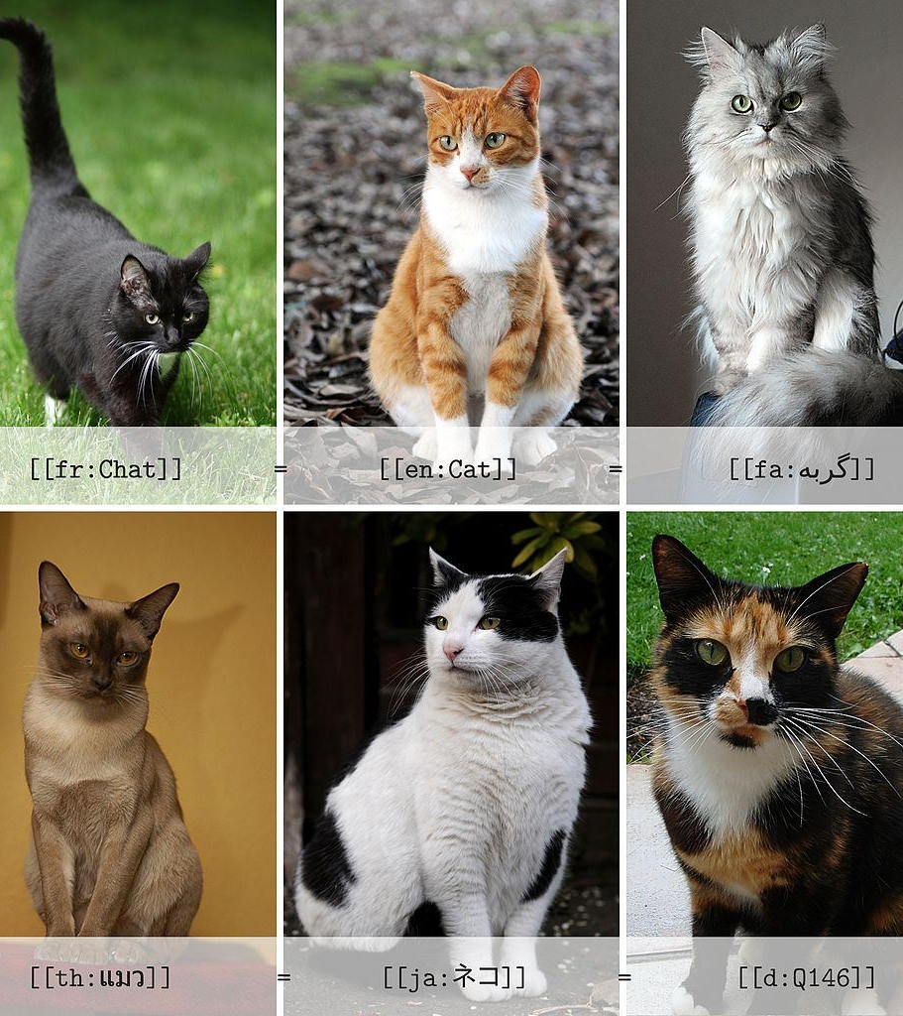
Cat Breed Identify
-From images!
ML Project by
Kimberly M.

Slide 2

What Problem Do We Solve?

Slide 3
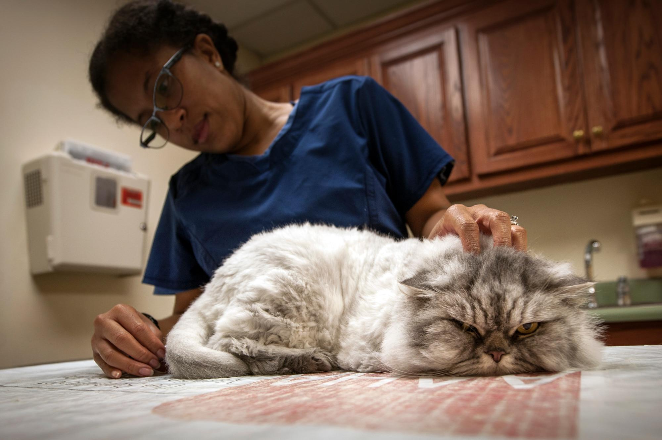
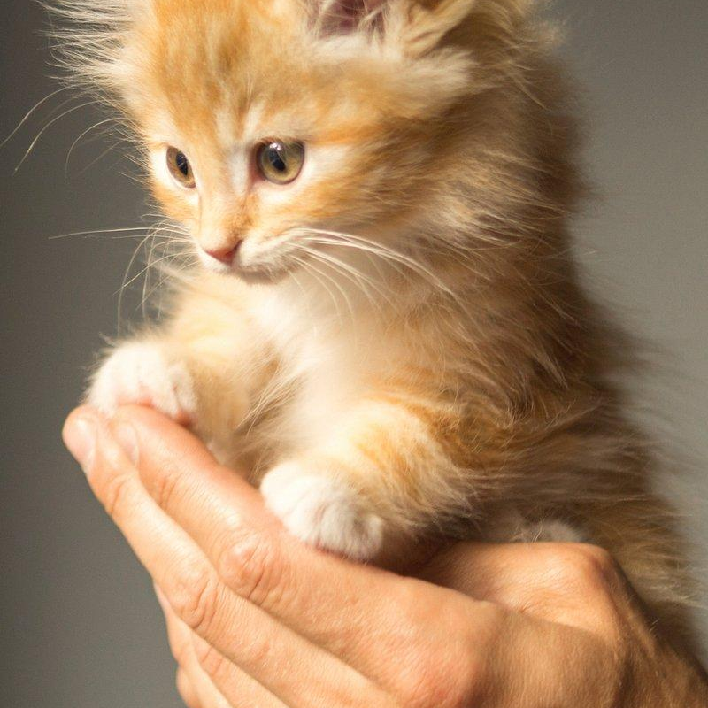
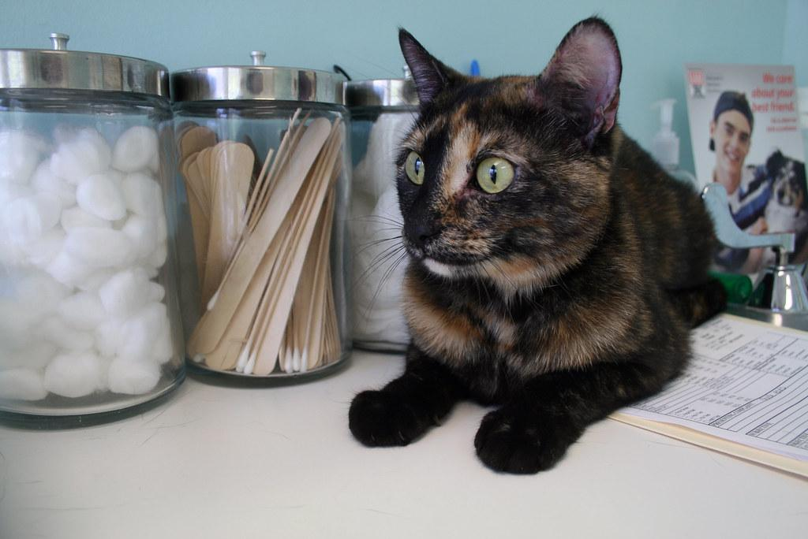
Identification For The Vet
Accurate breed identification is critical for veterinary diagnosis, genetic counseling, and proper care.
Many breeds have breed-specific health issues or treatment sensitivities.
Manual identification by eye is subjective and prone to error.

Slide 4
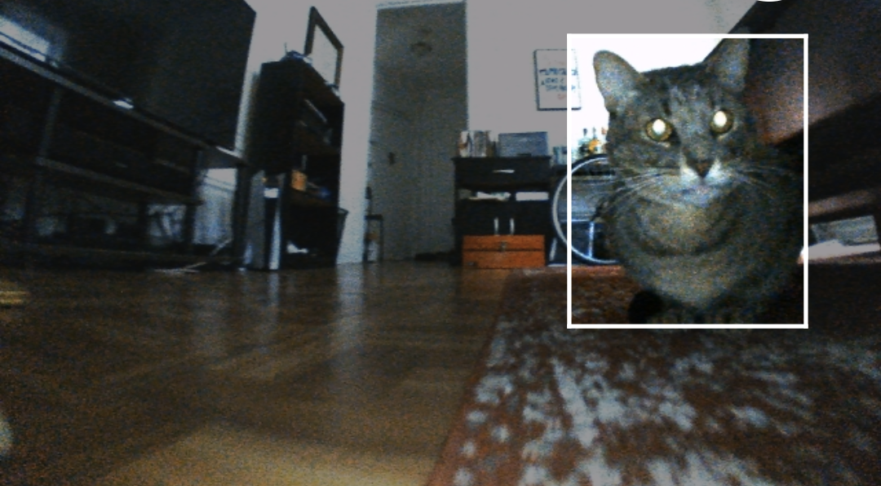
Solution: Identify from Images
Build an AI tool to support veterinarians with reliable, fast, breed identification from images.

Slide 5
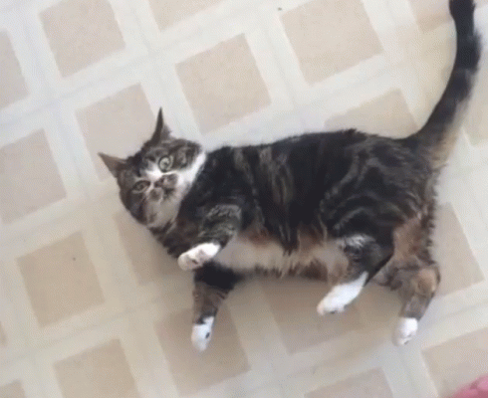
What is the ML approach used?

Slide 6
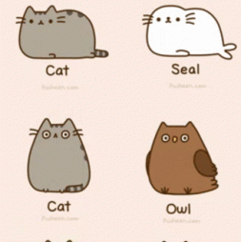
Dataset
Kaggle Cat Breed Dataset: ma7555
Picked this dataset due to it having images and being labeled
Over 80 breeds in this dataset
Skewed such as american shorthair being common
Unfortunately jpeg photos corrupt easy
Lots of processing to remove corrupted photos

Slide 7
Machine Learning Models
Built deep learning models (CNN-based) to automate cat breed classification.
Preprocessing:
Resized and normalized images for consistency.
Applied augmentation (rotations, flips, zooms) to improve generalization.
Data cleaning to remove corrupted images.
Early stopping and batch normalization for model stability.

Slide 8

Let’s look at the results and Demo!

Slide 9

Thank You!

